Slide 1
Open Innovation Track
Food Rescue Network
Zero-Latency Surplus Food Coordination & Emergency Rescue Radar
Connecting commercial food providers, rapid volunteer couriers, and community shelters in real-time with AI & Maps Grounding.

Slide 2



The Challenge Context
Awareness Isn't The Bottleneck — Logistics Is.
Massive Surplus Waste
Perishable Decay Timer
Fragmented Channels
Hot, edible meals discarded daily by hotels, hostels, and events while nearby shelters starve.
Strict temperature safety windows (<30 mins) require instant volunteer coordination.
Reliance on chaotic WhatsApp groups and notice boards with zero chain-of-custody tracking.

Slide 3
Real-Time Impact Metrics
42+
Verified Meals Successfully Rescued & Diverted to Shelters
Along with 84kg of CO₂ emissions prevented from municipal landfills.

Slide 4
Technical Implementation
Built with Modern Web & Google AI Stack
Frontend UI Engine
Google Maps & Gemini AI
Firebase Cloud State
React 19, TypeScript, and Tailwind CSS v4 delivering responsive mobile & desktop dashboards.
Gemini 3.5 Flash with native Google Maps grounding tool for shelter validation & transit intelligence.
Real-time Firestore sync, Firebase Auth Google sign-in, and subcollection dispatch messaging.

Slide 5
Core Feature 01
Live Urgency-Sorted Radar Feed
Synchronized Countdown Timers: Per-second countdown badges dynamically shift from green to amber and flashing rose under 10 minutes.
Available for Rescue
02:28 remaining
8kg Veg Pulao
Instant Provider Injection: One-tap commercial kitchen template pre-sets or custom form inputs broadcast live instantly.
Campus Central Mess • Hostel Quadrangle Dock
Packaging: Thermal Sealed Cans
Route Node: Seva Community Kitchen
State Transition Machine: Seamless lifecycle flow from → → .
Available
Claimed
Completed

Slide 6
Core Feature 02
Google Maps Grounding & Transit Intel
Gemini 3.5 Flash Integration
Queries live map data to verify donor street addresses, pinpoint nearby community food banks, and calculate precise driving/transit corridors.
AI Safety Triage: HACCP compliant food safety tips and temperature threshold advisories generated per batch item.
Real-Time Dispatch Chat: Scoped Firestore chat drawer allowing volunteers and providers to coordinate dock entry and timing.
✓ Verified Grounded Place Citations
✓ Universal Pre-filled Google Maps Direct Links

Slide 7
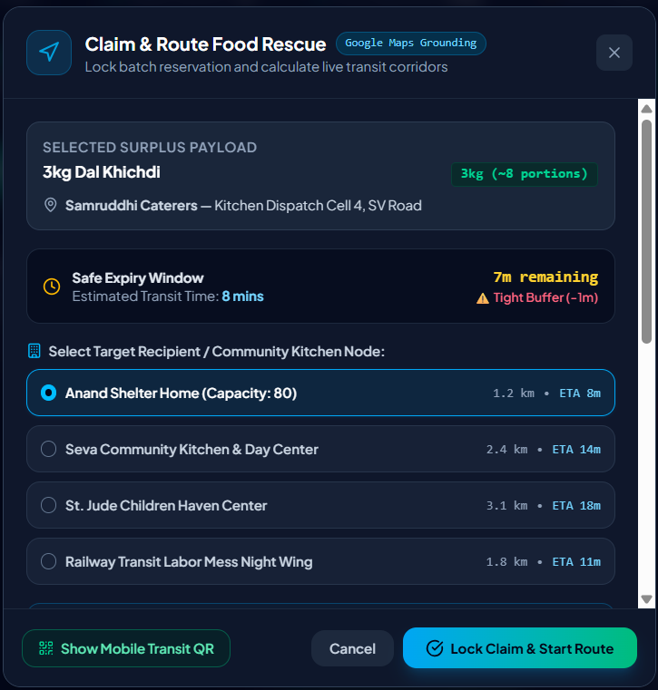


Core Feature 03
Secure QR Handover & Verification
Solving the hardest last-mile problem in food rescue: proving chain-of-custody and verifying successful delivery at the shelter doorstep.
• Unique cryptographic verification token generated upon claim lock.
• Scannable QR badge for instant shelter handover confirmation.
• Automatically increments global impact metrics upon finalization.
Cryptographic Handover Token

Slide 8
Inclusivity & Engagement
Field Accessibility Mode & Gamification
Field Accessibility Mode
Civic Rescuer Badges
Top Rescuers Leaderboard
One-tap toggle transforming the UI into high-contrast dark/amber mode with enlarged 44px+ touch targets for outdoor sunlight visibility.
Dynamic achievement unlocks (First Rescue, Speed Demon, Community Anchor) driven by completed metrics.
Regional volunteer ranking table with social peer cheers backed by real-time Firestore persistence.

Slide 9
Future Potential
Scalability & Municipal Deployment
01
02
03
Smart Logistics Routing
IoT Cold-Chain Sensors
Municipal ESG Reporting
Automated vehicle/volunteer capacity matching algorithm for multi-drop municipal redistribution.
Integration with Bluetooth thermal tags to monitor perishable core temperatures in transit automatically.
Certified ESG compliance and carbon credit export reports for corporate hotel and restaurant donors.

Slide 10


Build Something That Works.
Solve Something That Matters.
Food Rescue Network is fully functional, live on Firestore, and ready to eliminate municipal hunger. Thank you for your time!
GitHub:
https://github.com/ankita459/Food-Rescue-Network
Live Demo:
https://youtu.be/gmSBSAq0tOA

